Slide 1

UE19CS204 – Web Technologies Mini Project
Game On
Section - C
Gauri Menon PES1UG19CS163
Guhan K PES1UG19CS171
Harshita Vidapanakal PES1UG19CS185
GITHUB Link - https://github.com/kabbina/webtech-sem3-proj

Slide 2
Abstract
This web application is an online game interface. It allows the user to choose between two games - Tic Tac Toe and Quiz. The main technologies used are NodeJS, ReactJS and MongoDB. The application consists of the following functionalities:
Initially, a login/signup page is displayed. Any user is required to login in before playing(New users - sign up before login)
Subsequently, the new page is loaded where the user gets to choose one of the two games.
There are two paths from here, one for each game. Selection of the game redirects them to another new page.
Score is displayed after every game. A track of their previous scores is also maintained and displayed on request.

Slide 3
Technologies Used
MERN Stack
Libraries:
jwt
nodemon
mongoose
bcrypt
asyncHandler
axios
chakra
dotenv
react-redux
redux
react-router-dom
redux-devtools-extension

Slide 4
Member Contributions
Gauri (PES1UG19CS163)
Worked on styling of Game, header, Homepage, Register and Quiz pages. Also Worked on QuizActions and App.js as a part of the frontend and added the quiz questions to the database.
Guhan (PES1UG19CS171)
Frontend: worked on Tic-Tac-Toe, Dashboard, State Management with Redux Helped with styling of Game and Homepage Backend: worked on routing and handling of various Router Requests.
Harshita (PES1UG19CS185)
Login Authentication,User Registration, Middleware, algorithms to determine winner and score of games,including the above in a separate collection of the database; quiz, user and winner routes for the same.User Actions and Winner Actions in Frontend.

Slide 5
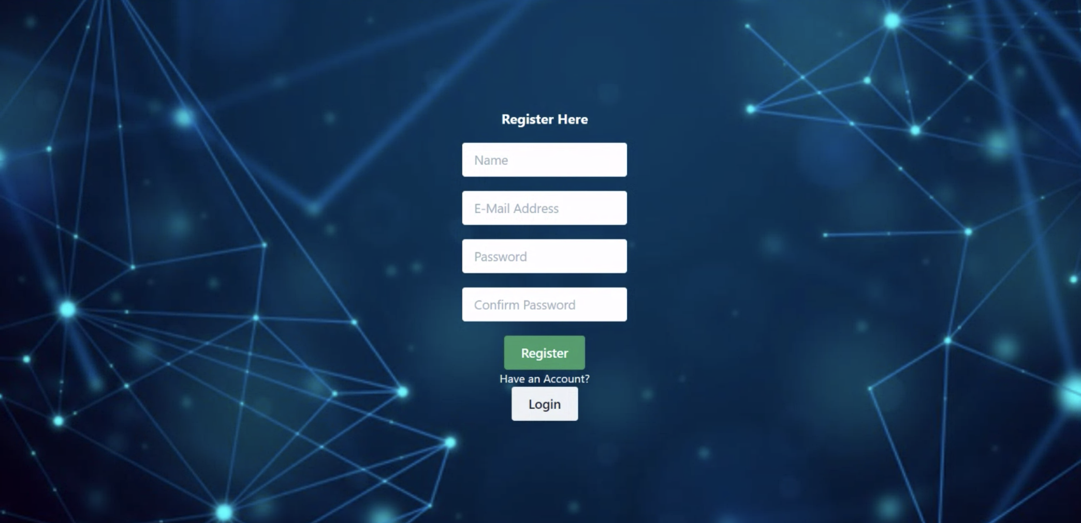
Register Page
Allows a new user to register

Slide 6
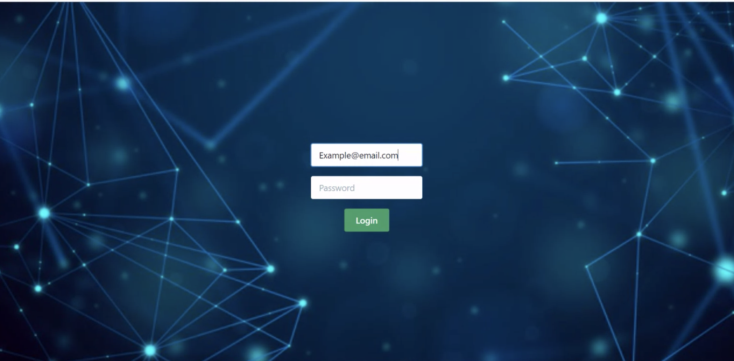
Login Page
Accepts user email, password and authenticates if the user is a valid , giving appropriate error when required

Slide 7
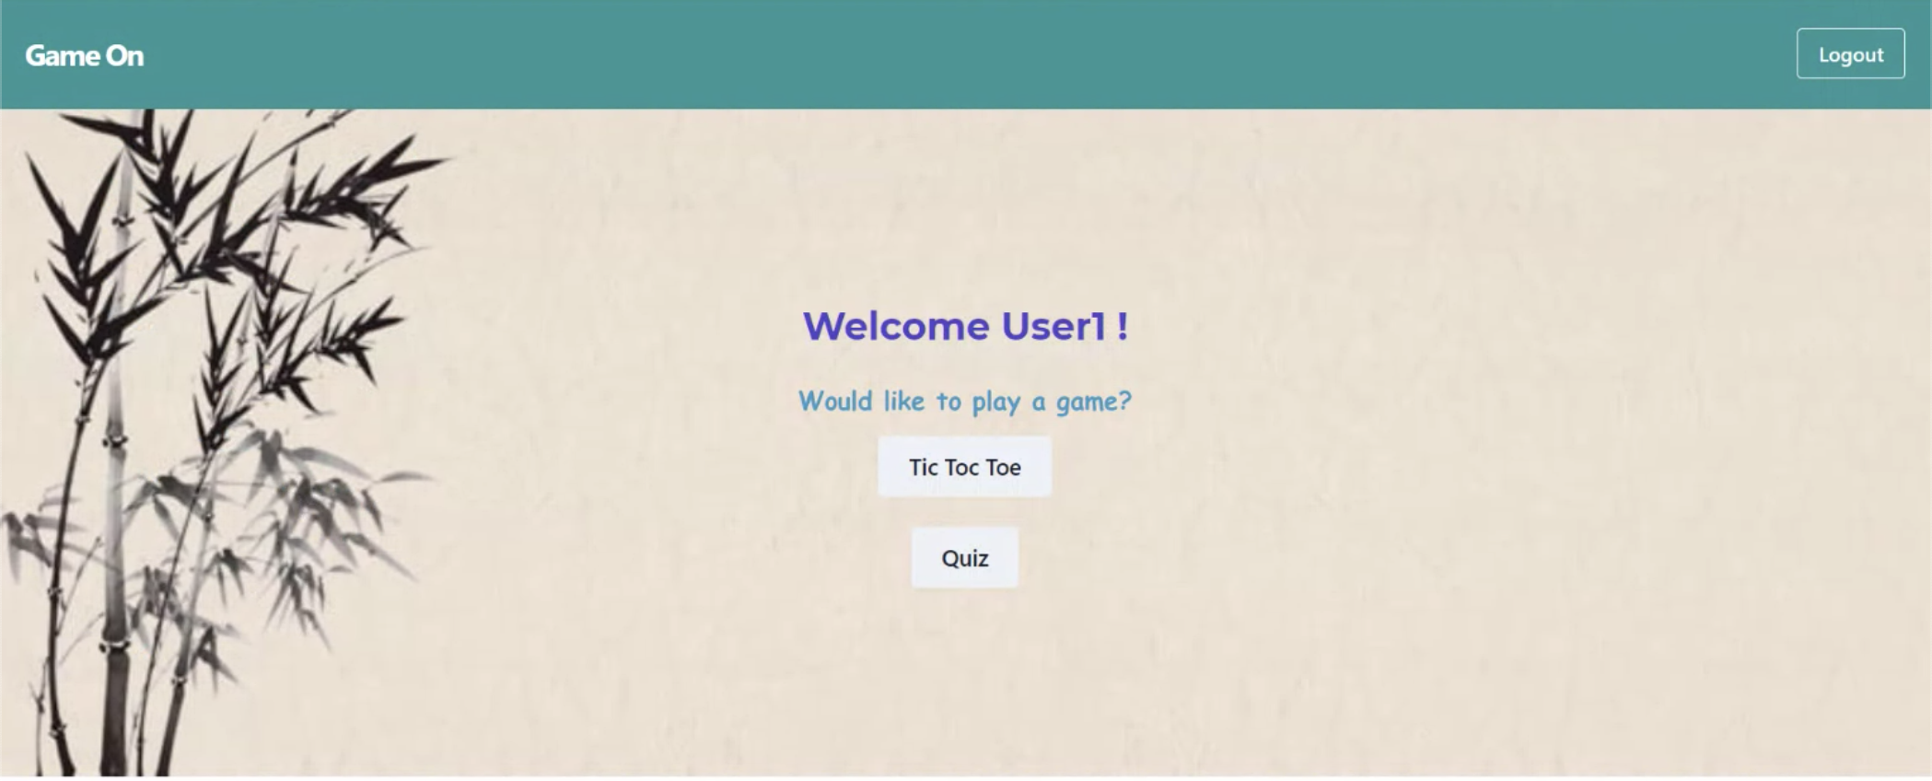
Home Page
Redirects user to appropriate game pages or allow the user to logout

Slide 8
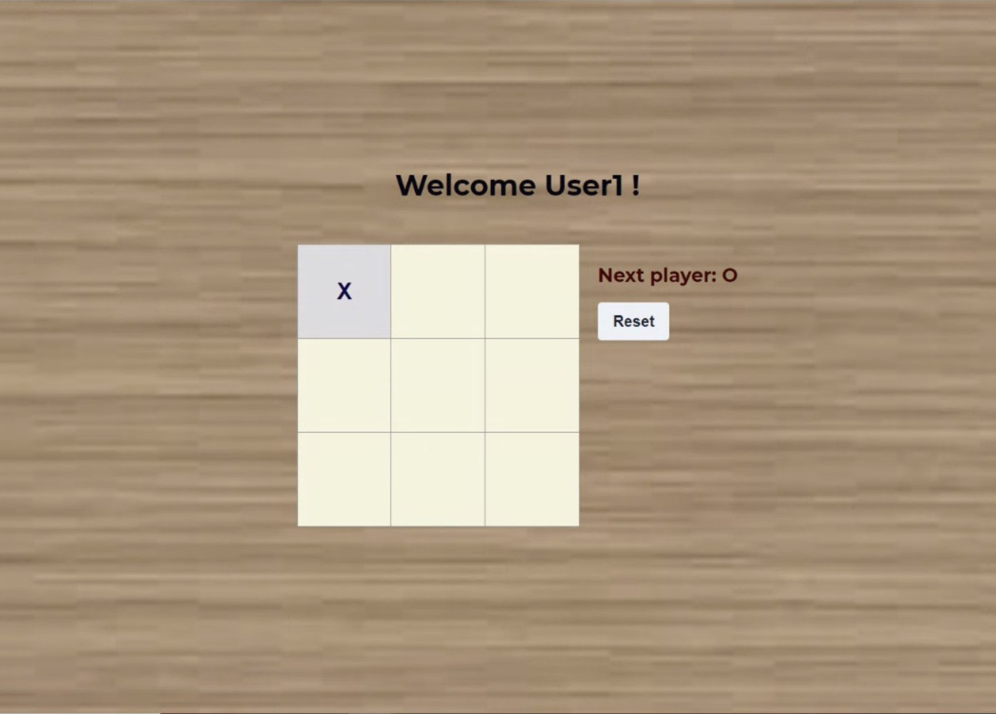
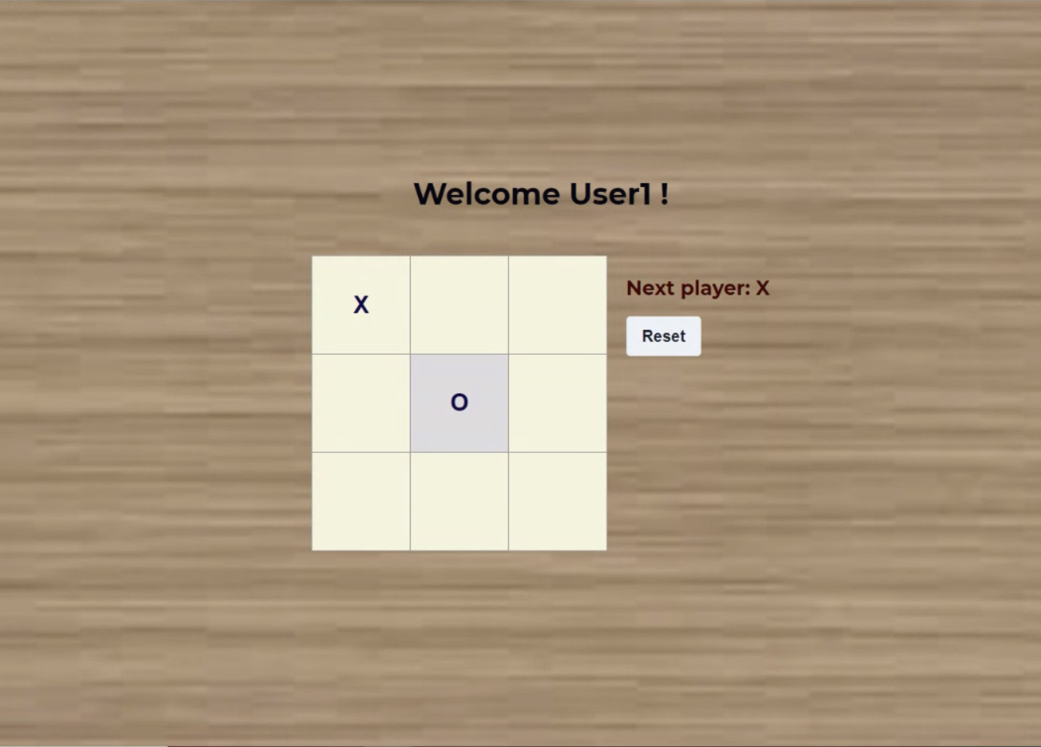
Tic-Tac-Toe
Prompts the next User to play

Slide 9
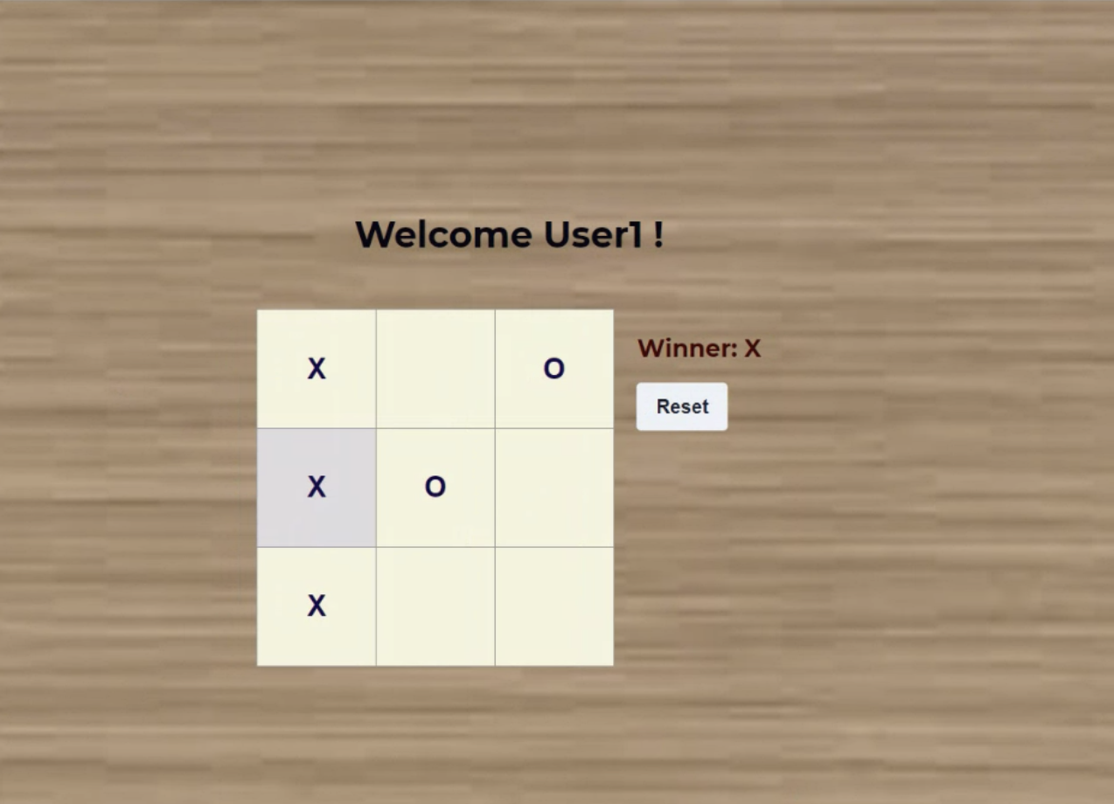
Tic-Tac-Toe Result
Case 1: User Wins

Slide 10
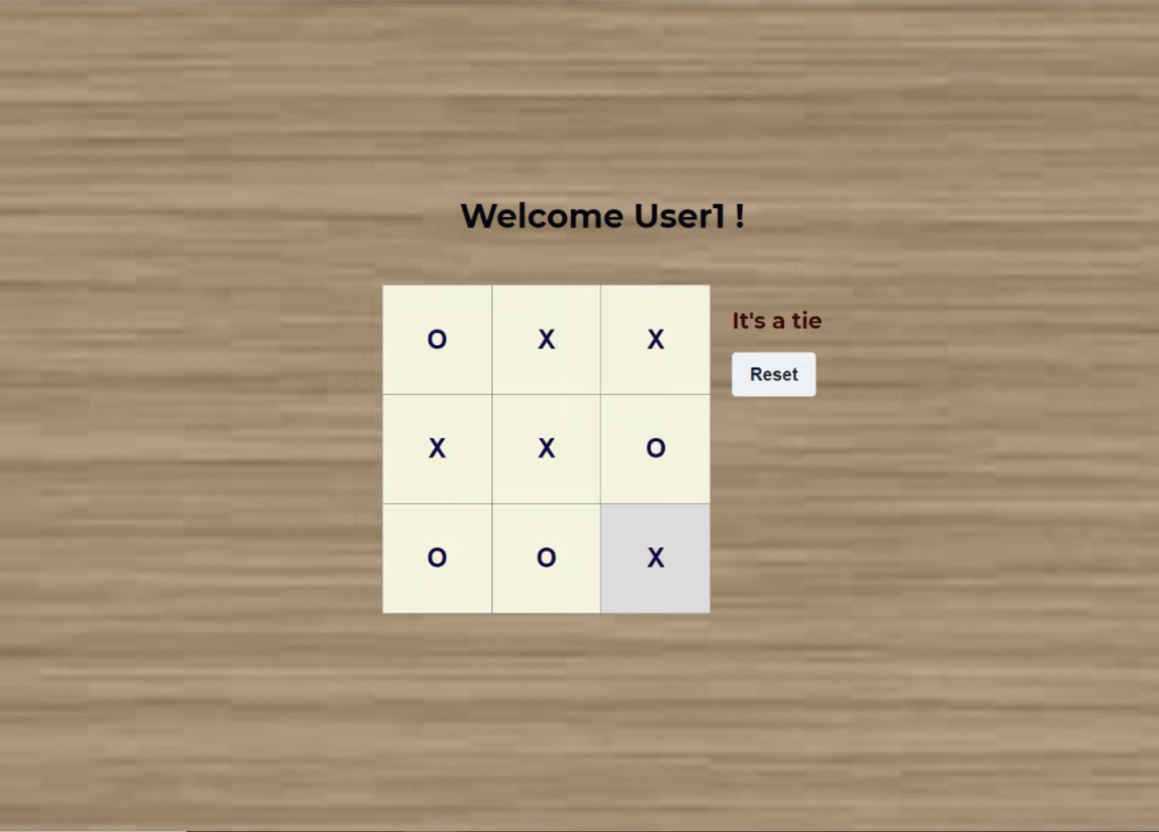
Tic-Tac-Toe Result
Case 2: Match Ties

Slide 11
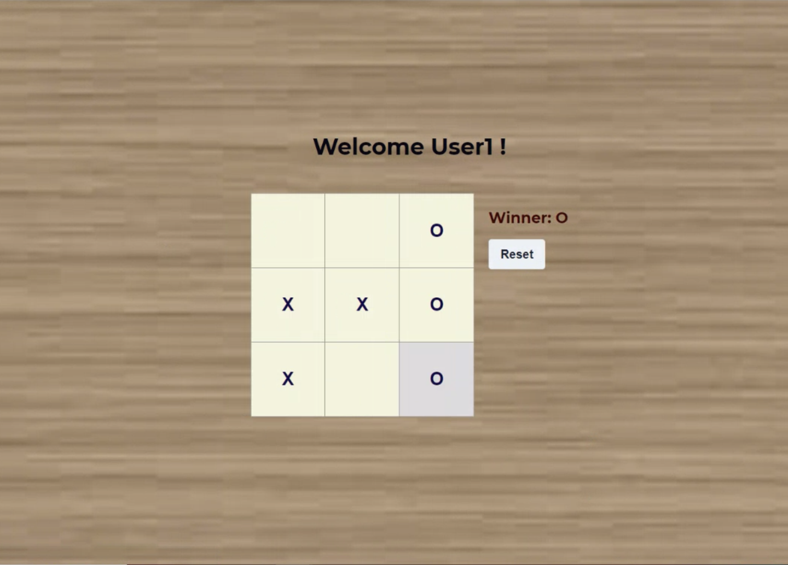
Tic-Tac-Toe Result
Case 3: User Loses

Slide 12
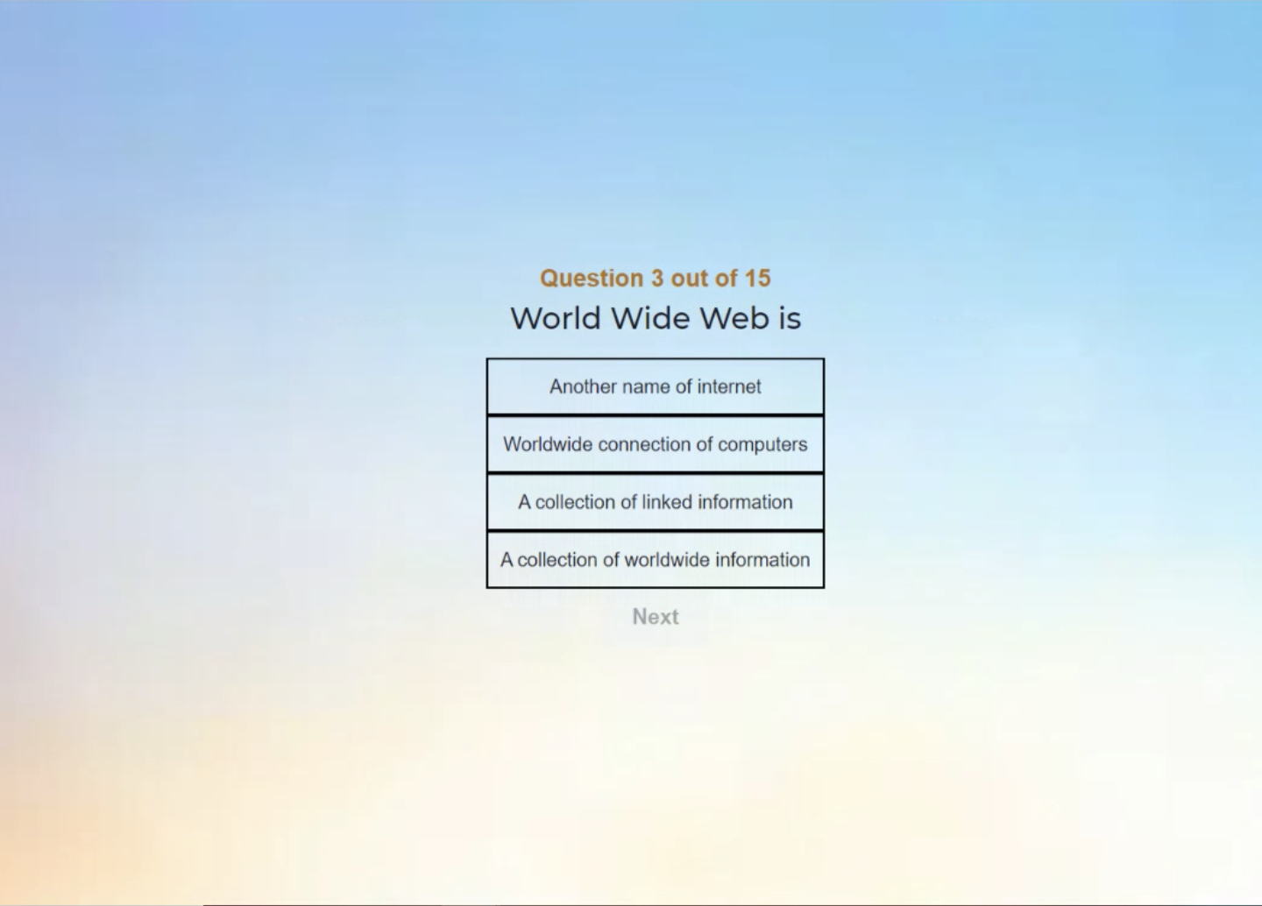
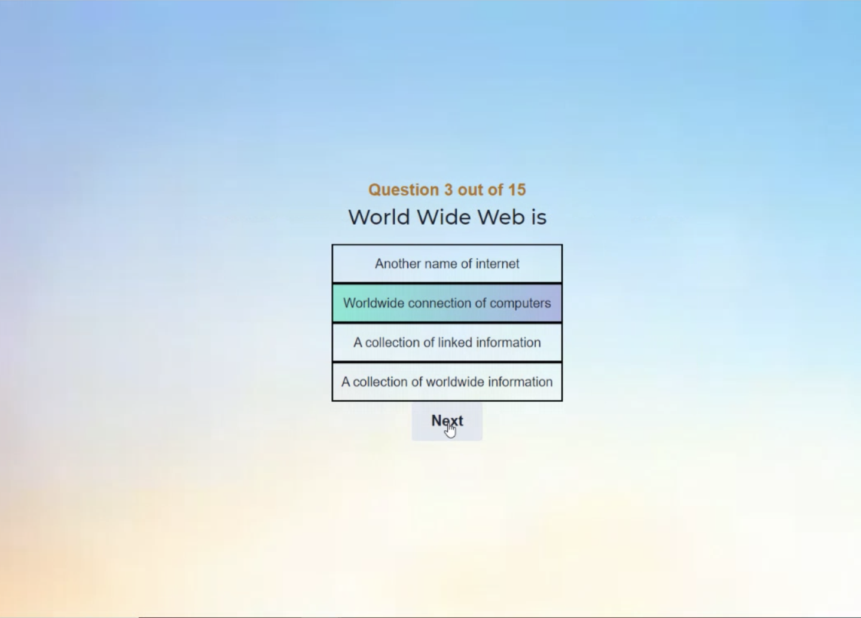
Quiz
A total of 15 questions are present. Attempting a question will enable the user to move on to the next question.

Slide 13
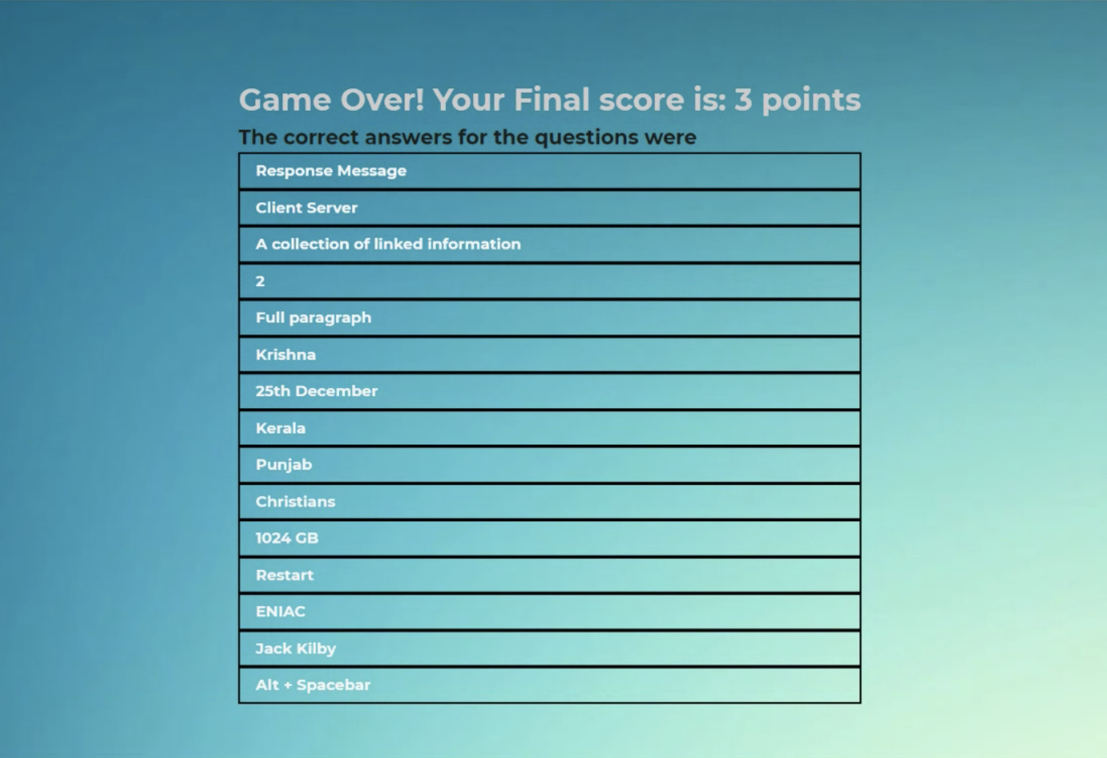
Quiz Result

